Slide 1
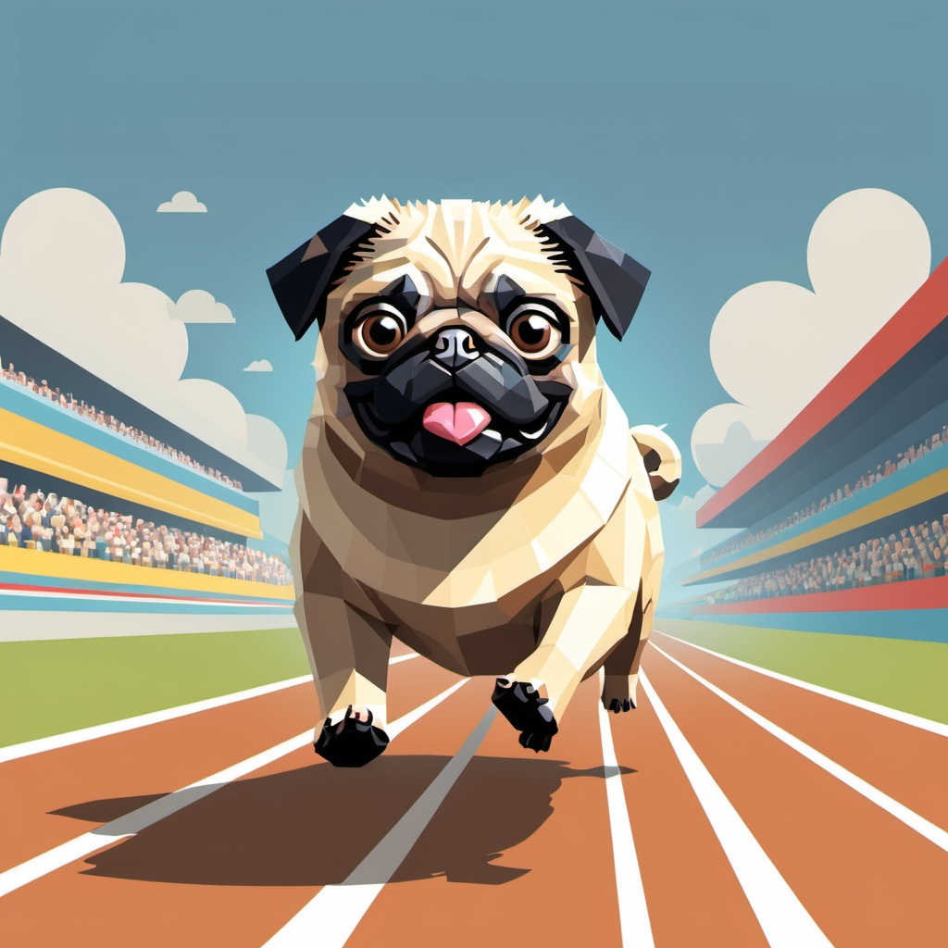
Pug Grand Prix
Present by:
Guilherme Trentini

Slide 2
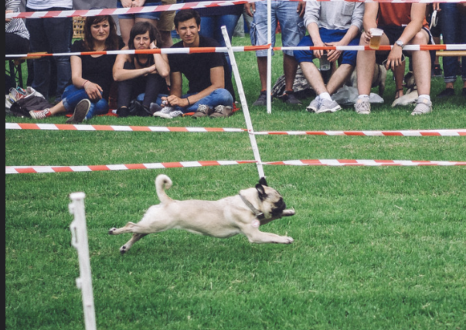
Agenda
Executive Summary
Game Description
Overview
Mechanics
Main Character
Opponents
Race Track
Menus & UI
Controls
Sounds
Summary

Slide 3

Executive Summary
Pug Grand Prix is a racing game where players race their pug in dynamic, obstacle-filled environments. The goal is to guide your pug through the track, mastering skills like dodging, and collecting power-ups to beat your opponents and become the champion of the pug racing.
The game blends casual fun with strategic challenges, with the park environment track. During the game you will experience fun sounds, challenging controls and an engaging and family-friendly experience.

Slide 4
Game Description
Overview
Multiplayer (2p)
Objective: win the race!
Fun environment and animations
Quest
Randomly generated obstacles and “power-ups”
The final objective is to win the "Pug Racing Championship" by making the best lap compared to your opponent

Slide 5

Game Description
Main Character
Pug
Opponents
The main opponents are the players that will compete against you, using the pug as their main character

Slide 6
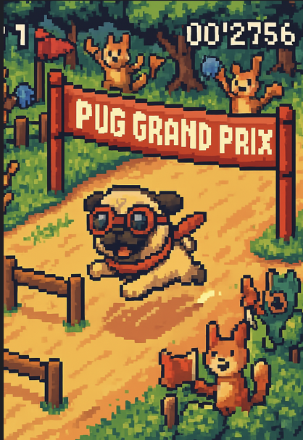
Race track
The game features A colorful environment designed to be visually appealing and challenging. At the moment is 1 track available, but will be more in the future
The Park: A grassy field with fountains and a Ferris wheel. Some barrels during the track to avoid or bark as a challenge

Slide 7
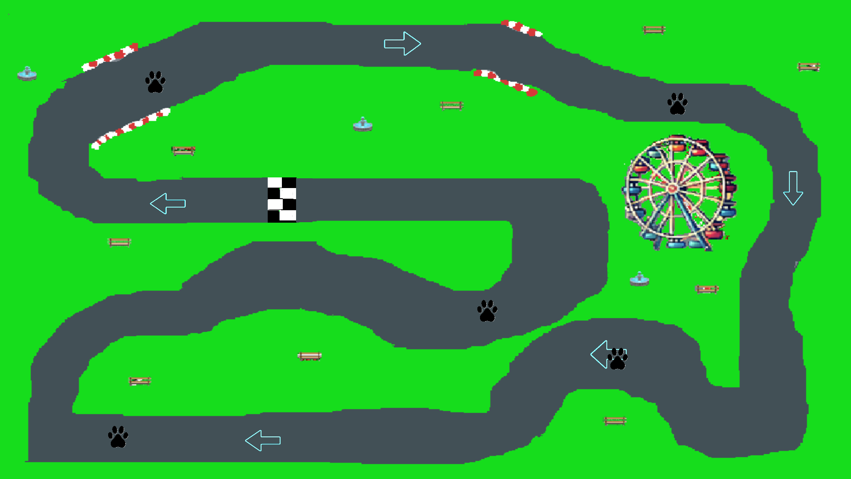
Park

Slide 8
Menus / Controls / Sounds
Menus
multiplayer (2p)
Controls
Keyboard Layout:
Arrow Keys/WASD: Move.
E: Barks (2 per run)
Sounds
The game features an audio design, including:
Background music: Will be on the start menu before goes to the map/race and during the map on the race
Sound effects: Pug barks, farts, obstacle collisions, power-up activations

Slide 9


Menus / Controls / Sounds
Accelerating

Slide 10
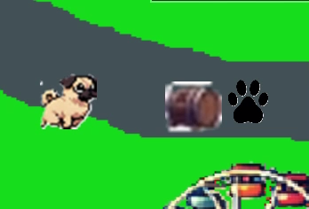
Menus / Controls / Sounds
Barking

Slide 11
Summary
Pug Grand Prix is a fun and family-friendly game that combines the thrill of racing with the joy of having an adorable pug as the main player. With Some engaging mechanics, the game appeals to casual players and families. Its unique humor and charm make it a good experience.

Slide 12
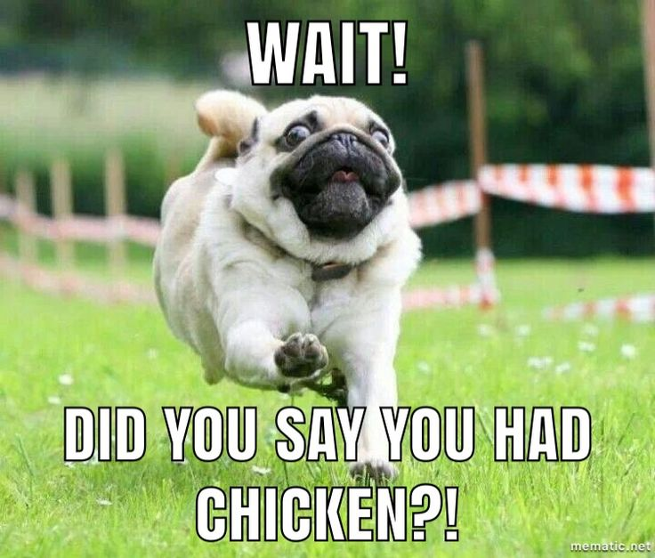
Thank you!

